Slide 1
Going Further with Scikit-Learn
Setting the scene
Understanding Naïve Bayes classification
Naïve Bayes example using scikit-learn

Slide 2
Section 1: Introduction
Setting the scene
Plan for this chapter
Probability terminology and notation

Slide 3
Setting the Scene
This chapter digs deeper into scikit-learn, to broaden your understanding of machine learning techniques
In the chapter, we'll cover Naïve Bayes classification
Fast and simple classification algorithm
Well suited for datasets with very high multidimensionality
In the lab, we'll cover Principal Component Analysis
An unsupervised learning technique
Reduces complexity of data, so you can spot relationships

Slide 4
Plan for this Chapter
We'll start off with a simple example using a hypothetical dataset
We'll discuss statistics/probability concepts and terminology
We'll also explain Bayes' Theorem, which is at the heart of Naïve Bayes classifiers in machine learning
Then we'll explore scikit-learn's support for Naïve Bayes classification
We'll focus on the Gaussian Naïve Bayes classifier, as an example
We'll show a demo based on the iris sample dataset

Slide 5
Probability Terminology and Notation
Naïve Bayes classifiers are based on probability
So we need to discuss basic probability notation/terminology…
P(y)
The probability of y (0 to 1)
P(y | X)
Conditional probability (i.e., probability of y, given X has happened)
E.g., probability of getting > 9 with two dice, given first die was a 6
P(x1, x2) = P(x1) P(x2)
Probability of independent things
E.g., throwing two 6s with two dice

Slide 6
2. Understanding Naïve Bayes Classification
Recap of classification
Sample dataset
Naïve Bayes assumptions about datasets
Bayes' Theorem
Applying Bayes' Theorem
Plugging in values
Putting it all together

Slide 7
Recap of Classification
Recall, classification is an example of supervised learning…
You start off with some labelled training data
With known features (inputs) and labels (results)
You fit a model to the training data
Builds a statistical model for the relationships between features and labels, based on probability
i.e., for a given set of feature combinations, what is the label value
You can then use the model to predict future labels
Given a set of features, uses the statistical model to guess the most probably label value

Slide 8
Sample Dataset
Features that determine if a person will go skiing on a particular day
Outcome
Weather | Temp | Snow depth | Weekday
Snow | +ve | Poor | No
Snow | +ve | Poor | Yes
Cloud | +ve | Poor | No
Sun | 0 | Poor | No
Sun | -ve | Good | No
Sun | -ve | Good | Yes
Cloud | -ve | Good | Yes
Snow | 0 | Poor | No
Snow | -ve | Good | No
Sun | 0 | Good | No
Snow | 0 | Good | Yes
Cloud | 0 | Poor | Yes
Cloud | +ve | Good | No
Sun | 0 | Poor | Yes
Go skiing?
No
No
Yes
Yes
Yes
No
Yes
No
Yes
Yes
Yes
Yes
Yes
No

Slide 9
Naïve Bayes Assumptions about Datasets
Naïve Bayes classification assumes each feature:
… is independent of every other feature
… has the same influence on the final outcome
The assumptions made by Naïve Bayes are naïve
Hence the name
These assumptions are generally incorrect in real-world situations, but it's a starting point

Slide 10
Bayes' Theorem
Here is Bayes' Theorem:
Finds the probability of an event occurring…
Given another event that's already occurred
What we're trying to do:
Find the probability of y…
Given the fact we have evidence that X has already occurred
P(X|y) P(y)
P(y|X)
=
P(X)

Slide 11
Applying Bayes' Theorem (1 of 4)
Here's how we can apply Bayes' Theorem in our scenario:
y is the outcome we're trying to deduce
E.g., go skiing today = true
X is all the feature values that we know as given for today
E.g., X = (sun, +ve temp, good snow depth, not weekday)
P(X|y) P(y)
P(y|X)
=
P(X)

Slide 12
Applying Bayes' Theorem (2 of 4)
We can rewrite P(X) as follows:
P(X) = P(x1, x2, x3, x4)
Where:
x1 is the observed value for feature 1, e.g., weather=sun
x2 is the observed value for feature 2, e.g., temp=+ve
x3 is the observed value for feature 3, e.g., snow depth=good
x4 is the observed value for feature 4, e.g., weekday=no
Naïve Bayes assumes features are independent, so we can rewrite the above expression as follows:
P(X) = P(x1) P(x2) P(x3) P(x4)

Slide 13
Applying Bayes' Theorem (3 of 4)
Thus we can rewrite Bayes:
As follows:
P(X|y) P(y)
P(y|X)
=
P(X)
P(x1|y) P(x2|y) P(x3|y) P(x4|y) P(y)
P(y|x1,x2,x3,x4)
=
P(x1) P(x2) P(x3) P(x4)

Slide 14
Applying Bayes' Theorem (4 of 4)
Here's the formula for "probability we do go skiing"
Here's the formula for "probability we don't go skiing"
We can divide the formulae, to eliminate the denominator
P(x1|yes) P(x2|yes) P(x3|yes) P(x4|yes) P(yes)
P(yes|x1,x2,x3,x4)
=
P(x1) P(x2) P(x3) P(x4)
P(x1|no) P(x2|no) P(x3|no) P(x4|no) P(no)
P(no|x1,x2,x3,x4)
=
P(x1) P(x2) P(x3) P(x4)
P(yes|x1,x2,x3,x4)
P(x1|yes) P(x2|yes) P(x3|yes) P(x4|yes) P(yes)
=
P(no|x1,x2,x3,x4)
P(x1|no) P(x2|no) P(x3|no) P(x4|no) P(no)

Slide 15
Plugging in Values (1 of 4)
Remember we're looking for these probabilities
x1 weather=sun
x2 temp=+ve
x3 snow depth=good
x4 weekday=no
(We skied on 9 days in total, and didn't on 5 days in total)
P(x1|yes) = 3/9
Weather
 | yes | no | P(yes) | P(no)
Sun | 3 | 2 | 3/9 | 2/5
Cloud | 4 | 0 | 4/9 | 0/5
Snow | 2 | 3 | 2/9 | 3/5
Total | 9 | 5 | 9/9 | 5/5
P(x1|no) = 2/5

Slide 16
Plugging in Values (2 of 4)
Remember we're looking for these probabilities
x1 weather=sun
x2 temp=+ve
x3 snow depth=good
x4 weekday=no
(We skied on 9 days in total, and didn't on 5 days in total)
P(x2|yes) = 2/9
Temperature
 | yes | no | P(yes) | P(no)
+ve | 2 | 2 | 2/9 | 2/5
0 | 4 | 2 | 4/9 | 2/5
-ve | 3 | 1 | 3/9 | 1/5
Total | 9 | 5 | 9/9 | 5/5
P(x2|no) = 2/5

Slide 17
Plugging in Values (3 of 4)
Remember we're looking for these probabilities
x1 weather=sun
x2 temp=+ve
x3 snow depth=good
x4 weekday=no
(We skied on 9 days in total, and didn't on 5 days in total)
P(x3|yes) = 6/9
Snow depth
 | yes | no | P(yes) | P(no)
Good | 6 | 1 | 6/9 | 1/5
Poor | 3 | 4 | 3/9 | 4/5
Total | 9 | 5 | 9/9 | 5/5
P(x3|no) = 1/5

Slide 18
Plugging in Values (4 of 4)
Remember we're looking for these probabilities
x1 weather=sun
x2 temp=+ve
x3 snow depth=good
x4 weekday=no
(We skied on 9 days in total, and didn't on 5 days in total)
P(x4|yes) = 3/9
Snow depth
 | yes | no | P(yes) | P(no)
W/day | 3 | 3 | 3/9 | 3/5
W/end | 6 | 2 | 6/9 | 2/5
Total | 9 | 5 | 9/9 | 5/5
P(x4|no) = 3/5

Slide 19
Putting it all Together
We can now put all our values into our formula
Given p(yes) + p(no) = 1, we can rearrange as follows:
P(yes|x1,x2,x3,x4)
P(x1|yes) P(x2|yes) P(x3|yes) P(x4|yes) P(yes)
=
P(no|x1,x2,x3,x4)
P(x1|no) P(x2|no) P(x3|no) P(x4|no) P(no)
3/9 * 2/9 * 6/9 * 3/9 * 9/14
0.01058
=
=
2/5 * 2/5 * 1/5 * 3/5 * 5/14
0.00685
P(yes|x1,x2,x3,x4) = 0.01058 = 0.61
0.01058 + 0.00685
P(no|x1,x2,x3,x4) = 0.00685 = 0.39
0.01058 + 0.00685

Slide 20
3. Naïve Bayes Example using Scikit-Learn
Overview
Using the Gaussian Naïve Bayes classifier
Doing modelling
Identifying classification errors

Slide 21
Overview
Scikit-learn has several Naïve Bayes classifier classes available
Gaussian Naïve Bayes
Multinomial Naïve Bayes
Complement Naïve Bayes
Bernoulli Naïve Bayes
They all have the same principles
They differ in the assumptions that they make regarding the distribution of P(x_{i} | y)
For more info, see:
https://scikit-learn.org/stable/modules/naive_bayes.html

Slide 22
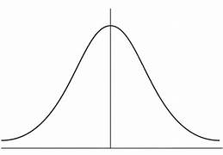
Using the Gaussian Naïve Bayes Classifier
The Gaussian Naïve Bayes classifier assumes a Gaussian distribution for the probability of feature values
We'll use the Gaussian Naïve Bayes classifier to predict the species for an iris
Based on the Gaussian distribution of features
i.e., sepal length, sepal width, petal length, petal width

Slide 23
Doing Modelling
from sklearn.naive_bayes import GaussianNB
…
iris = load_iris()
X = pd.DataFrame(iris.data)
X.columns = iris.feature_names
y = iris.target
X_train, X_test, y_train, y_test = train_test_split(X, y, test_size=0.4)
gnb = GaussianNB()
gnb.fit(X_train, y_train)
y_pred = gnb.predict(X_test)
y_sideBySide = list(zip(y_test, y_pred))
print("\nActual vs. predicted species\n", y_sideBySide)
print("GaussianNB model accuracy: ", metrics.accuracy_score(y_test, y_pred))
ex01-DoModelling.py

Slide 24
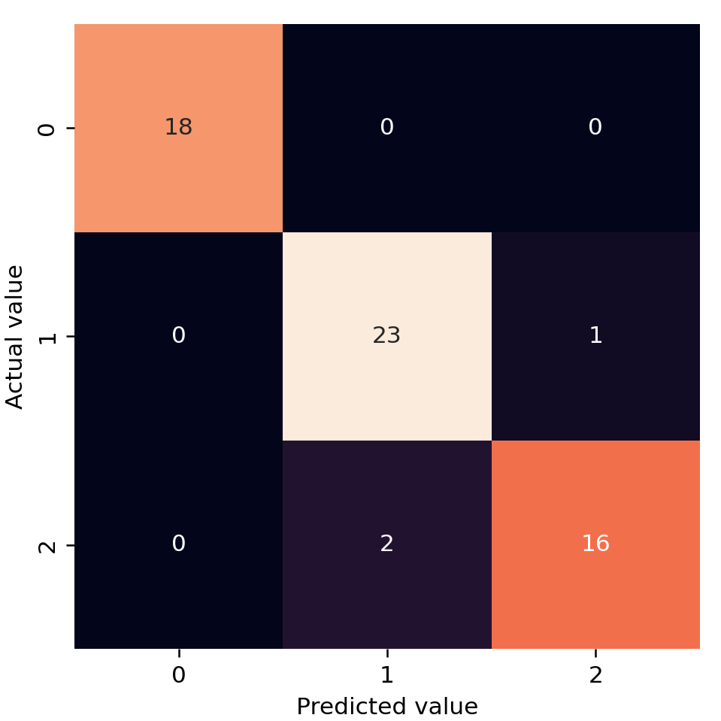
Identifying Classification Errors
We can create a confusion matrix that indicates classification errors, and draw a heatmap to visualize this info
ex02-IdentifyClassificationErrors.py
… same code as previous example …
from sklearn.metrics import confusion_matrix
import seaborn as sns
import matplotlib.pyplot as plt
cm = confusion_matrix(y_test, y_pred)
sns.heatmap(cm, square=True, annot=True, cbar=False)
plt.xlabel('Predicted value')
plt.ylabel('Actual value');
plt.show()

Slide 25
Summary
Setting the scene
Understanding Naïve Bayes classification
Naïve Bayes example using scikit-learn

